Slide 1
Chameleon; Constantly altering identity
By Maria Agustina Sanchez

Slide 2
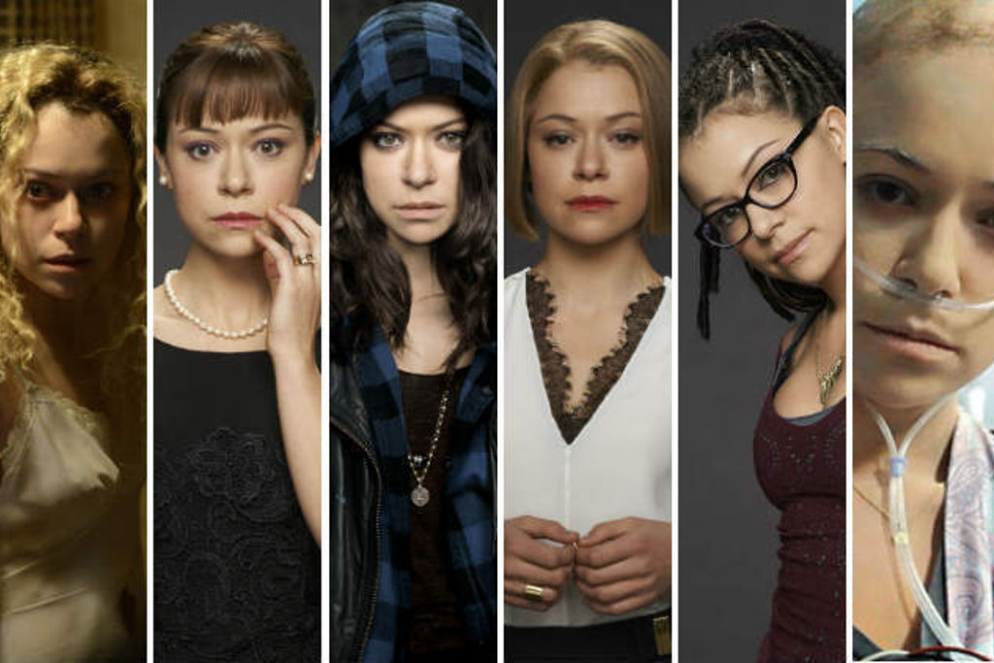
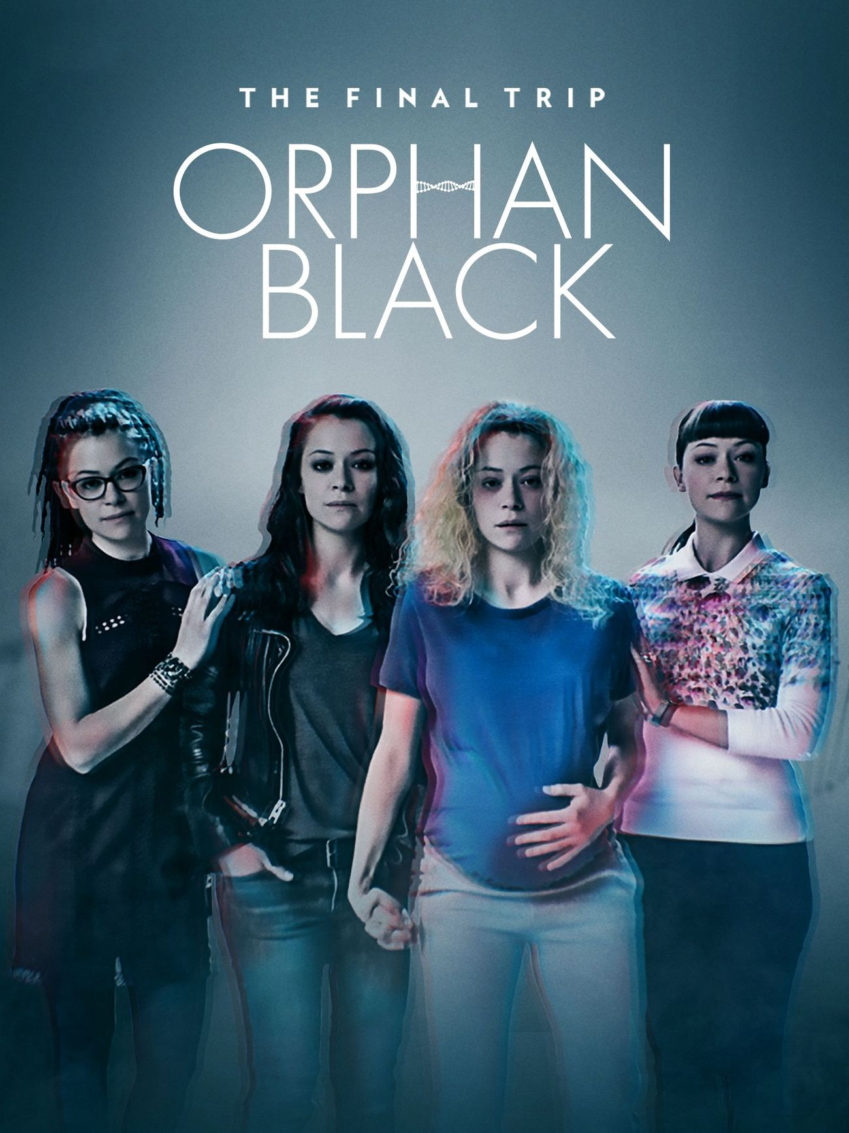
Orphan Black (TV series)
Tatiana Maslany portraits several identical people who are clones. The series focuses on Sarah Manning, a woman who assumes the identity of one of her fellow clones, Elizabeth Childs, after witnessing Childs’s suicide.
The series raises issues about the moral and ethical implications of human cloning, and its effect on issues of personal identity.

Slide 3
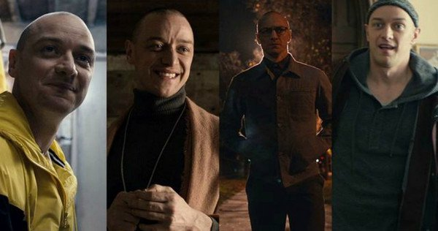
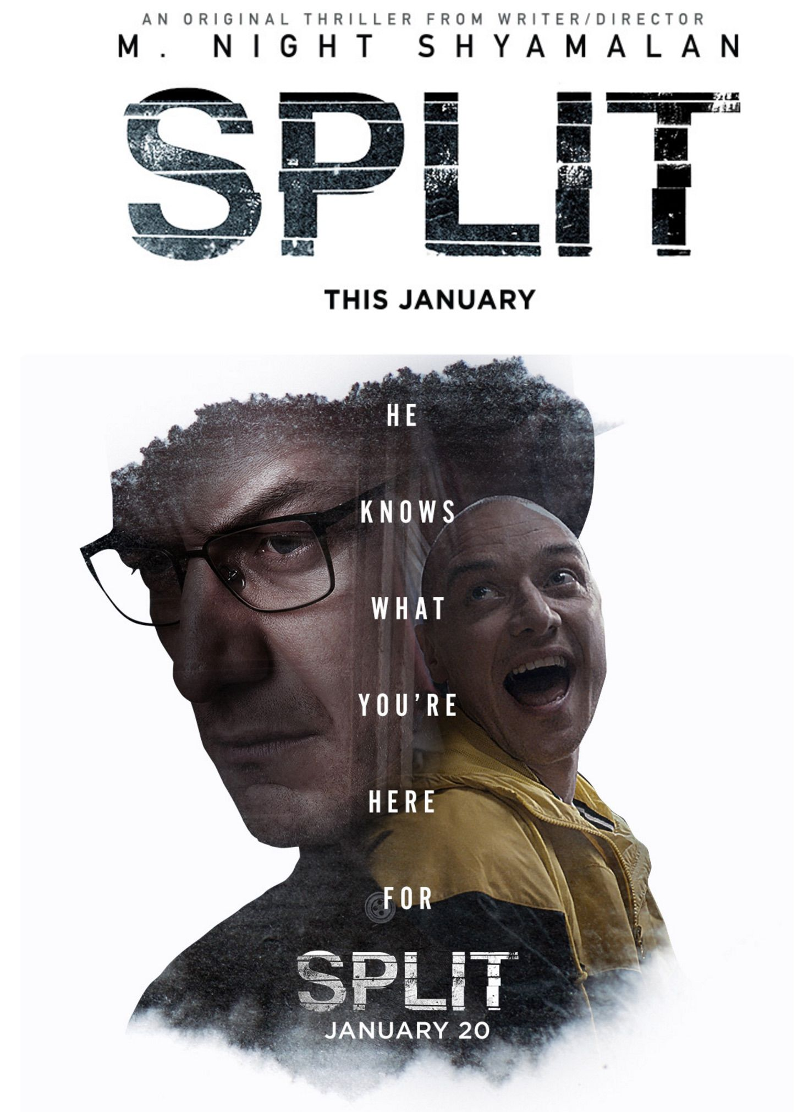
Split (movie)
Split personality is a disorder characterized by the presence of two or more distinct personality states which could be caused by sever trauma as a child.
The movie Split is about a guy who has 23 different personalities in himself. The actor portraits different characters with different personalities throughout the movie.

Slide 4
5 Questions
5 questions you want to solve within my project.
1) How can we truly know how the real “us” is?
2) What are all the different possibilities of “us’?
3) How much does the environment that we live in and people we surround ourselves with, will potentially change who we are going to be in the future?
4) How much does our personality or looks change depending on who we are with?
5) Why do we keep stuff from people? Why don’t we want them to know our “true self”?

Slide 5
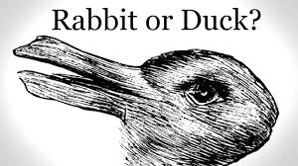
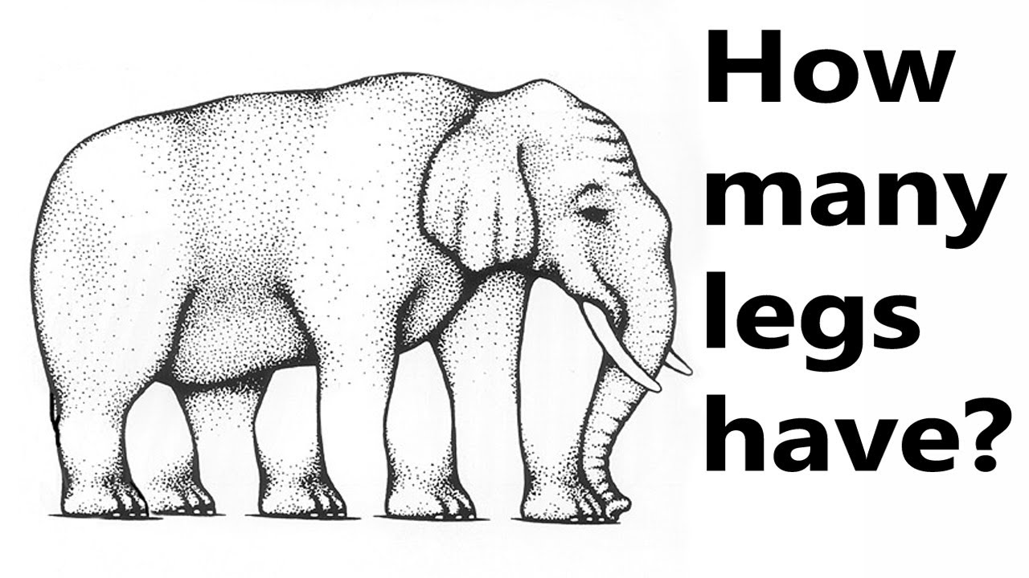
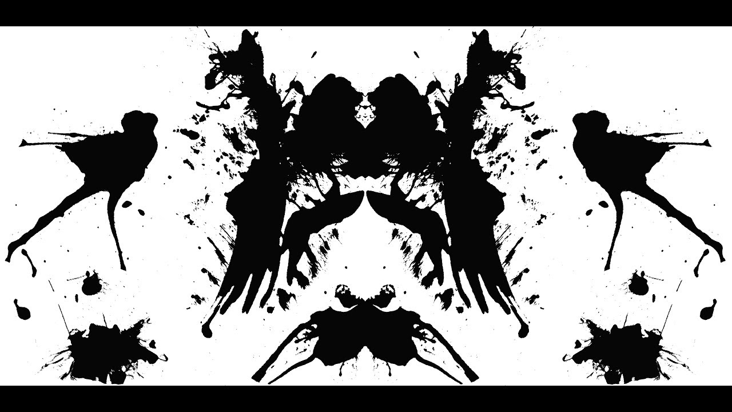
Idea #1 What do you see?

Slide 6

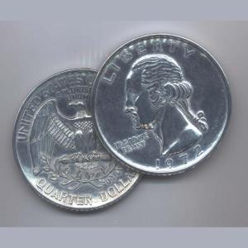
Idea #2 Day vs Night Head vs Tails

Slide 7
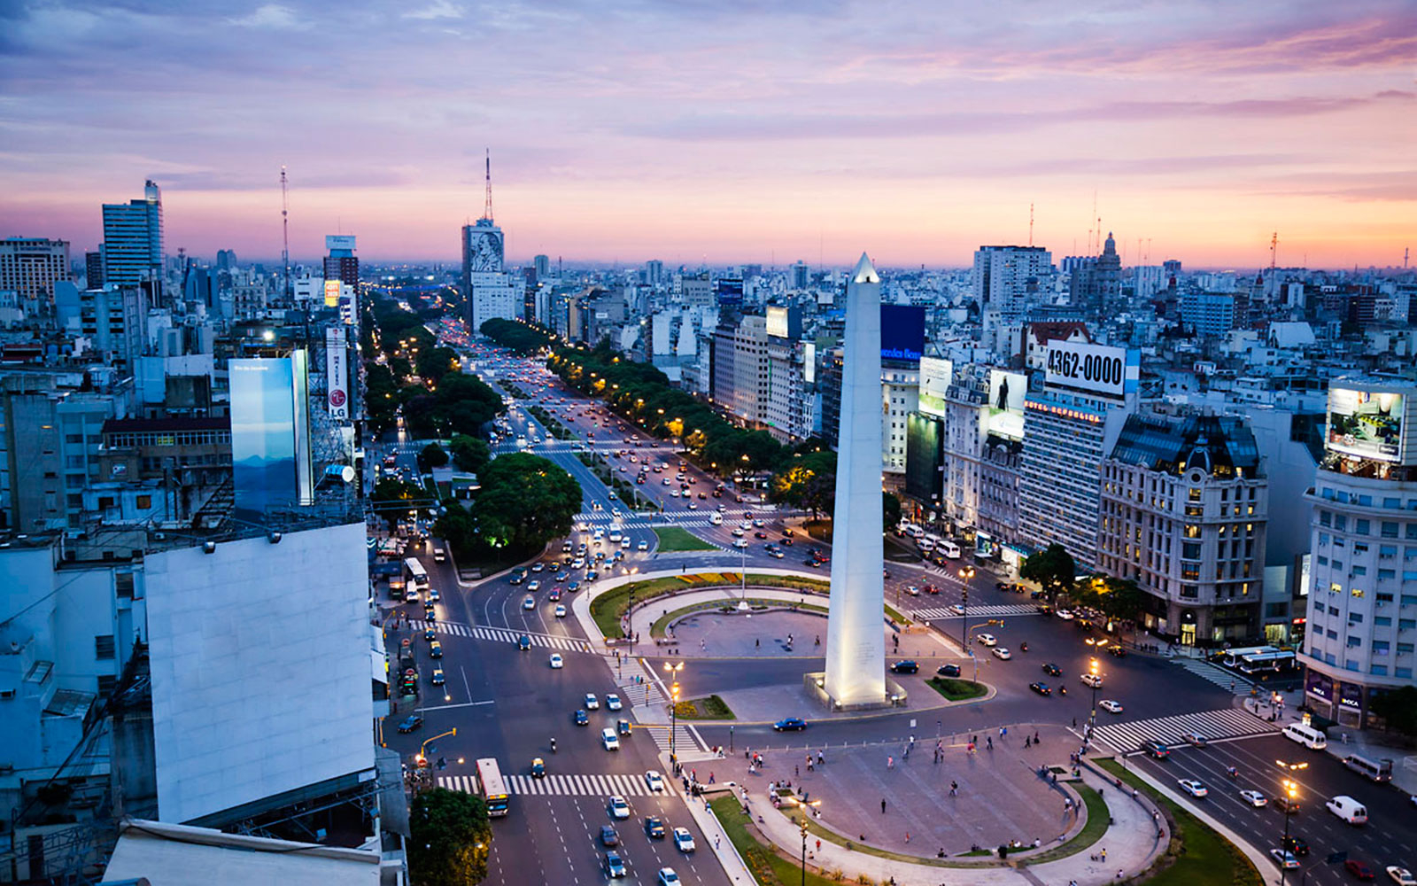



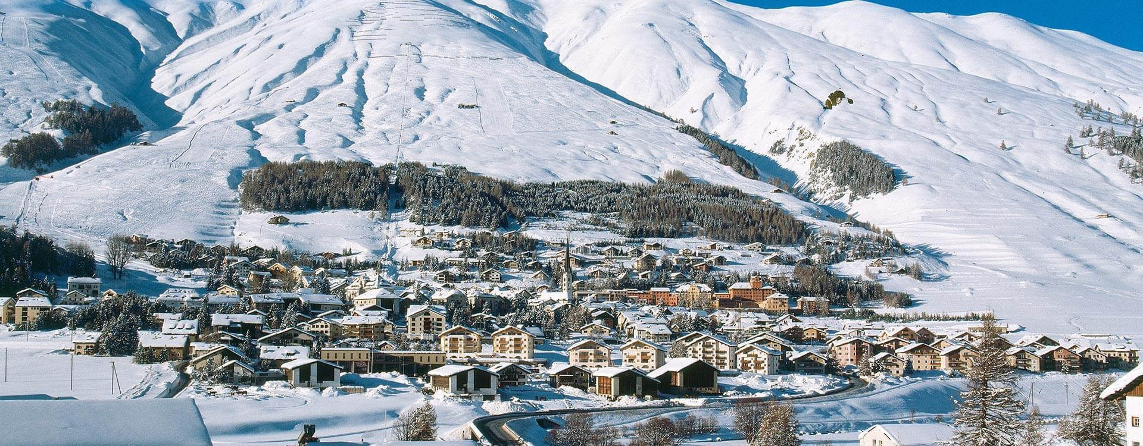
Idea #3 Agus in different places

